Slide 1
FINAL PROJECT PRESENTATION
Shift Academy Data Science Batch 5
Kelompok 3
Hendra Ronaldi | Jilan Alya | Zahra Zahira
Dataset: Hotel Booking Demand
Mentor: Faris

Slide 2
Use Case: Cancellation Predictions
Use Case Summary
Objective & Problem Statement
Untuk mengetahui penyebab booking cancellations
Business Benefit
Memberikan informasi kepada business development yang dapat digunakan untuk membantu upaya penurunan booking cancellations
Source Data
Hotel Booking Demand (Kaggle)
Methodology / Analytic Technique
Descriptive Analysis
Statistical Analysis
Data Preprocessing
Machine Learning Models
Expected Outcome
Faktor-faktor yang berpengaruh signifikan terhadap booking cancellations
Dashboard
Challenges
Data banyak
Imbalance Class
Missing Values
Success Criteria
Akurasi minimal 80%
ROC minimal 80%
Recall minimal 80%

Slide 3
BACKGROUND
Terjadinya pembatalan booking sering terjadi dalam bisnis perhotelan. Hal tersebut dapat terjadi karena disebabkan oleh berbagai faktor.
Hal ini dapat menyebabkan kerugian karena menyebabkan jadwal booking yang dibatalkan menjadi kosong yang seharusnya dapat diisi oleh calon konsumen hotel lain yang berminat pada hari booking yang sama.
Oleh karena itu, penting bagi pemilik bisnis perhotelan untuk mengidentifikasi faktor apa saja yang menyebabkan terjadinya pembatalan booking dan membuat model untuk memprediksi hal tersebut.

Slide 4
METHODOLOGY
Supervised Learning:
Klasifikasi
Data Preprocessing:
Exploratory Data Analysis (EDA)
Handling missing values: simple imputer (seperti angka 0)
Handling Imbalance target class: oversampling SMOTE atau undersampling
Label encoding untuk variabel category 2 value, One Hot Encoding untuk variabel multi value
Feature Engineering (seperti PCA, dll.)

Slide 5
Machine Learning Models
Random Forest Classifier
LGBM Classifier
Decision Tree
KNN
Logistic Regression
Hyper parameter tuning dengan grid search cross validation

Slide 6
PROJECT TIMELINE
Date
23/05/21
26/05/21
30/05/21
02/06/21
06/06/21
9/06/21
13/06/21
16/06/21
20/06/21
-
-
-
Proposal
EDA & Preprocessing
Modelling & Evaluation
Final Presentation

Slide 7
Data Understanding
Data Understanding
Target
Is_canceled: Value indicating if the booking was canceled (1) or not (0)
Features
Hotel: (H1 = Resort Hotel or H2 = City Hotel)
Lead_time: Number of days that elapsed between the entering date of the booking into the PMS and the arrival date
Arrival_date_year
Arrival_date_month
Arrival_date_week_number
Arrival_date_day_of_month
Stays_in_weekend_nights: Number of weekend nights (Saturday or Sunday) the guest stayed or booked to stay at the hotel
Stays_in_week_nights: Number of week nights (Monday to Friday) the guest stayed or booked to stay at the hotel
Adults: number of adults
Children: number of children
Babies: number of babies

Slide 8
Data Understanding
Meal: Type of meal booked. Categories: Undefined/SC – no meal package; BB – Bed & Breakfast; HB – Half board (breakfast and one other meal – usually dinner); FB – Full board (breakfast, lunch and dinner)
Country: Country of origin.
Market_segment: Market segment designation. In categories, the term “TA” means “Travel Agents” and “TO” means “Tour Operators”
Distribution_channel: Booking distribution channel. The term “TA” means “Travel Agents” and “TO” means “Tour Operators”
Is_repeated_guest: Value indicating if the booking name was from a repeated guest (1) or not (0)
Previous_cancellations: Number of previous bookings that were cancelled by the customer prior to the current booking
Previous bookings not cancelled: Number of previous bookings not cancelled by the customer prior to the current booking

Slide 9
Data Understanding
Reserved Room Type: Code of room type reserved.
Assigned Room Type: Code for the type of room assigned to the booking. Sometimes the assigned room type differs from the reserved room type due to hotel operation reasons (e.g. overbooking) or by customer request.
Booking Changes: Number of changes/amendments made to the booking from the moment the booking was entered on the PMS until the moment of check-in or cancellation
Deposit Type: Indication on if the customer made a deposit to guarantee the booking. This variable can assume three categories: No Deposit, Non Refund, Refundable..
Agent: ID of the travel agency that made the booking
Company: ID of the company/entity that made the booking or responsible for paying the booking.
Days in waiting list

Slide 10
Data Understanding
Customer Type: Type of booking, assuming one of four categories: Contract, Group , Transient , Transient-party.
ADR: Average Daily Rate as defined by dividing the sum of all lodging transactions by the total number of staying nights
Required car parking spaces: Number of car parking spaces required by the customer
Total of Special Request: Number of special requests made by the customer (e.g. twin bed or high floor)
Reservation status: Reservation last status, assuming one of three categories: Canceled, Check-Out, No-Show.
Reservation status date: Date at which the last status was set. This variable can be used in conjunction with the Reservation Status to understand when was the booking canceled or when did the customer checked-out of the hotel.

Slide 11
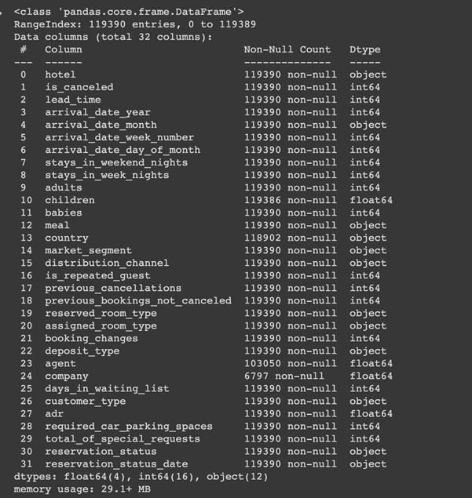
Data Info
Data Understanding
Data Shape
Total Row: 119390
Total Column: 32 (1 Target, 31 Features)

Slide 12
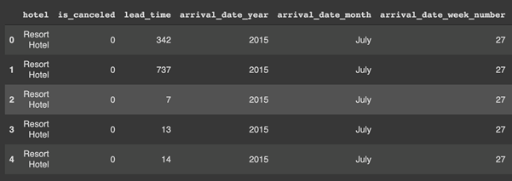
Sample Data
Data Understanding

Slide 13
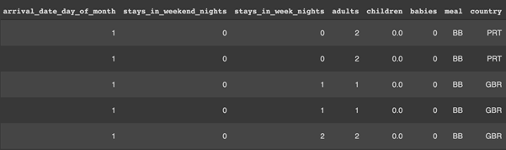
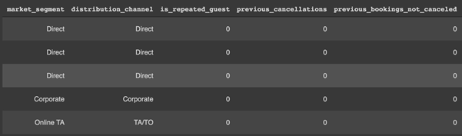
Sample Data
Data Understanding

Slide 14
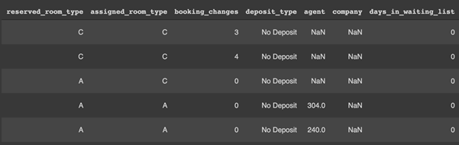
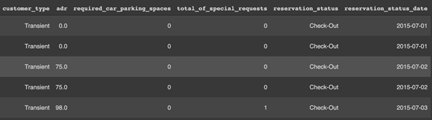
Sample Data
Data Understanding

Slide 15
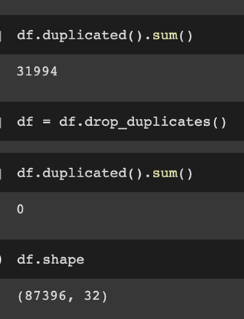
Check Duplication
*Data Preprocessing
Remove duplicate values
31994 duplicate values
Total data after removal duplicated values = 87396

Slide 16
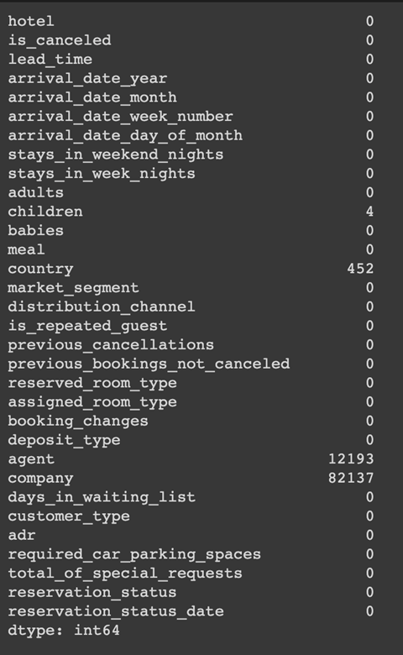
Handling Missing Values
Data Preprocessing
Before

Slide 17
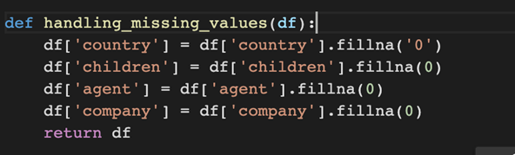
Handling Missing Values
Data Preprocessing
Handling missing values
Asumsi missing values di kolom Children, Agent, dan Company tidak memiliki children dan tidak melalui agent dan company. Missing value di kolom Country dikategorikan sebagai ‘other’.
Country: di isi string ‘other’
Children, Agent, dan Company diisi angka 0

Slide 18
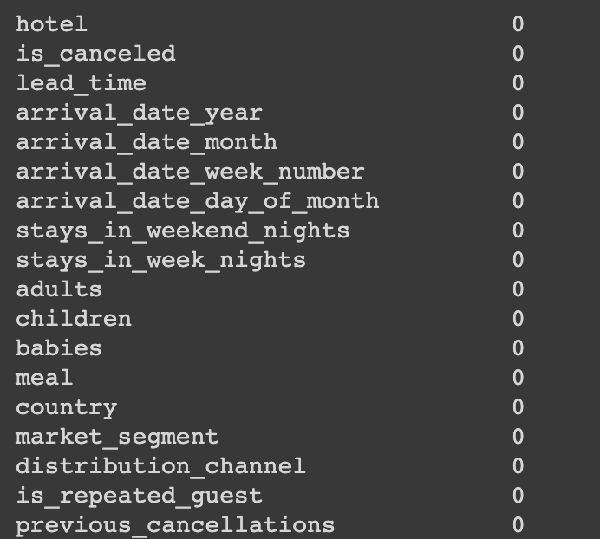
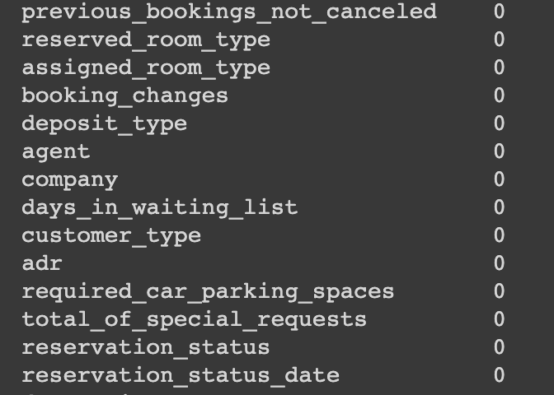
Handling Missing Values
After

Slide 19
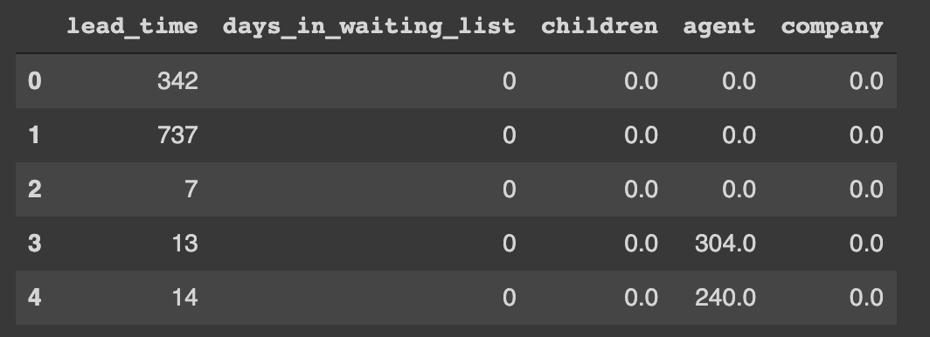
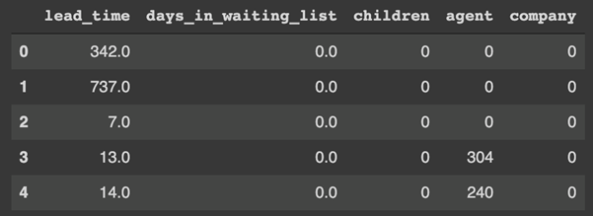
Data Type Correction
Data Preprocessing
lead_time -> float
days_in_waiting_list -> float
children -> integer
agent -> integer
company -> integer

Slide 20
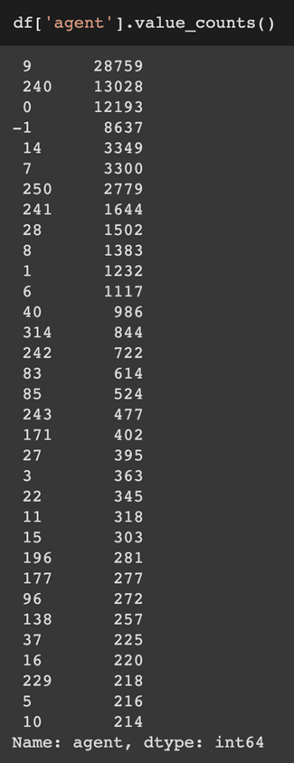
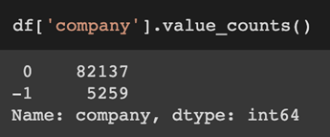
Grouping Minority
Data Preprocessing
Menggabungkan nilai-nilai yang fraksinya dibawah 10% menjadi satu fraksi di kolom country, agent, dan company.

Slide 21
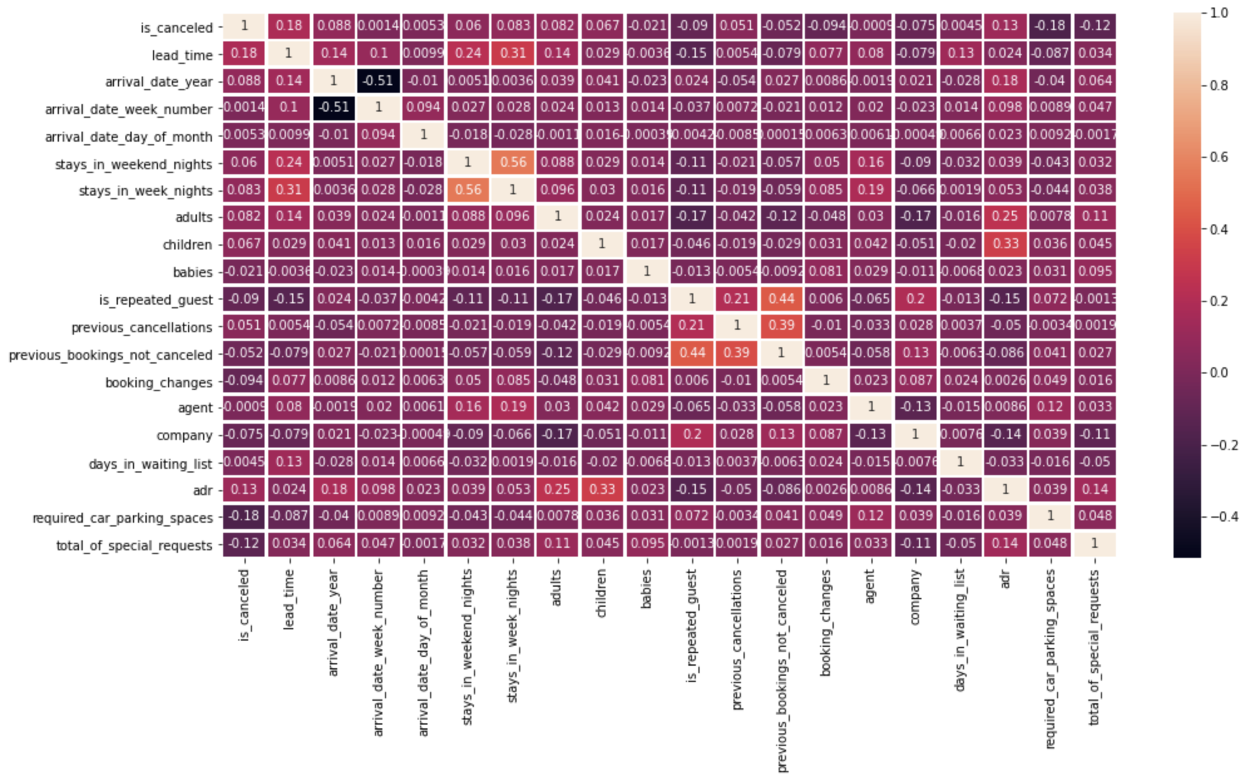
Korelasi
*Data Preprocessing
Notes:
Tidak ada yang tinggi

Slide 22
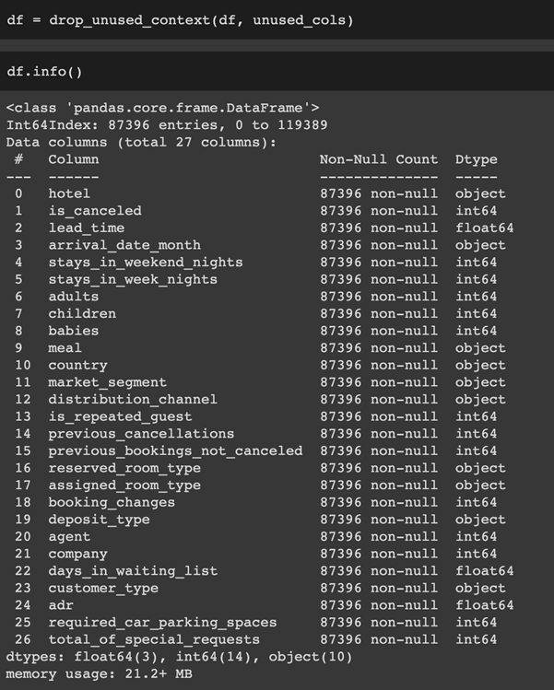
Drop Column
Data Preprocessing
Kolom yang tidak digunakan
'Arrival_date_year': irrelevant, always predict cancelled on future booking
'Arrival_date_week_number': use month
'Arrival_date_day_of_month': use month
'Reservation_status': cause data leak, duplicate meaning with target
'reservation_status_date': useless information
Notes:
Tidak ada yang tinggi

Slide 23
Label Encoding
Data Preprocessing
Multivalues :
One Hot Encoding
‘Arrival_date_month'
'Meal'
'Country'
'Market_segment'
'Distribution_channel'
'Reserved_room_type
'Assigned_room_type'
'Deposit_type',
'Customer_type'
'Agent'
Binary Values:
Label Encoding
‘Hotel’
‘Company’

Slide 24
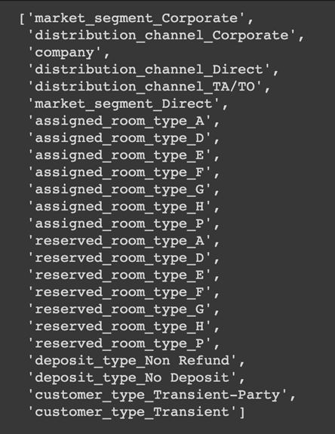
Remove Collinearity after Encoding
Data Preprocessing
Notes:
Tidak ada yang tinggi, threshold nya 0.75

Slide 25
Data Partition
Data Preprocessing
Data dibagi menjadi 3 bagian
Train (56,25%) -> untuk training model
Validation (18,75%) -> untuk validasi model
Test (25%) -> sebagai data baru untuk pengujian model hasil training

Slide 26
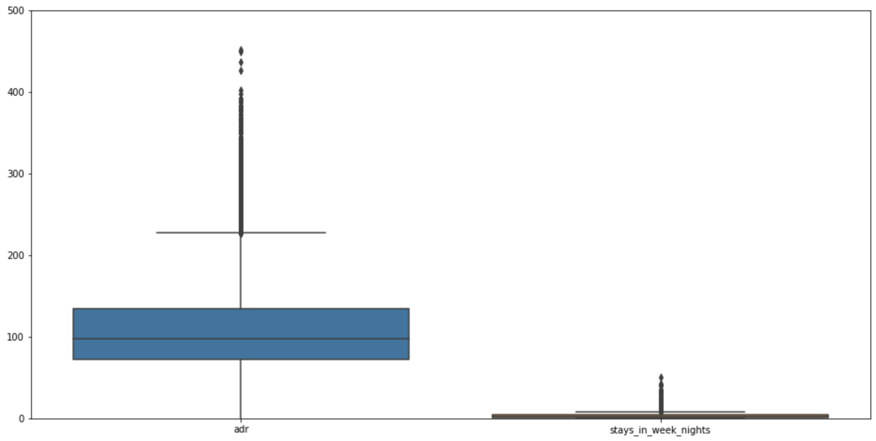
Data Scaling
Data Preprocessing
Scaling dilakukan menggunakan StandardScaler dari library scikit-learn untuk menyeragamkan skala data seperti stays_in_week_nights di rentang puluhan dengan kolom adr di rentang ratusan

Slide 27
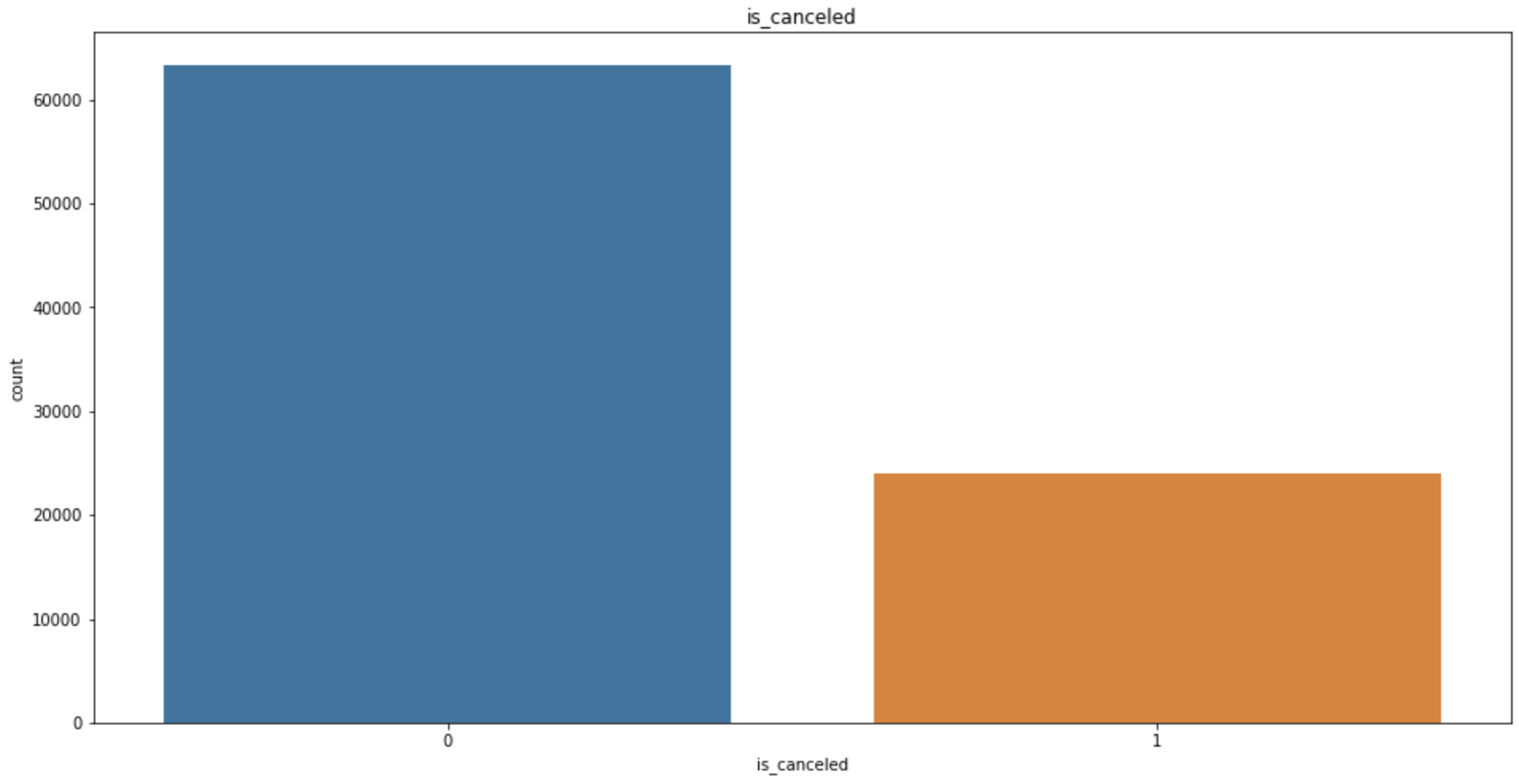
Imbalance Class
Data Visualization
72,5%
Handling imbalance class:
Karena data sangat banyak, digunakan simple random undersampling, didapat total data untuk train dan validation sebesar 36024 baris dan 126 features.
27,5%

Slide 28
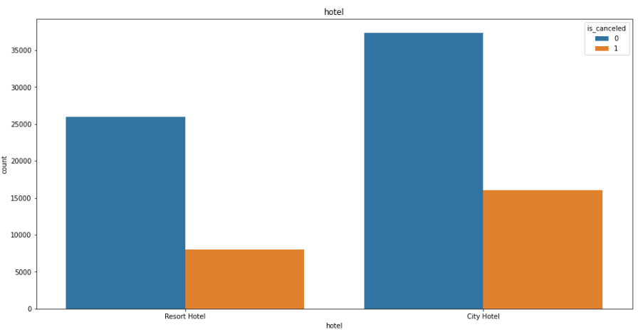
Resort Hotel vs City Hotel
Data Visualization

Slide 29
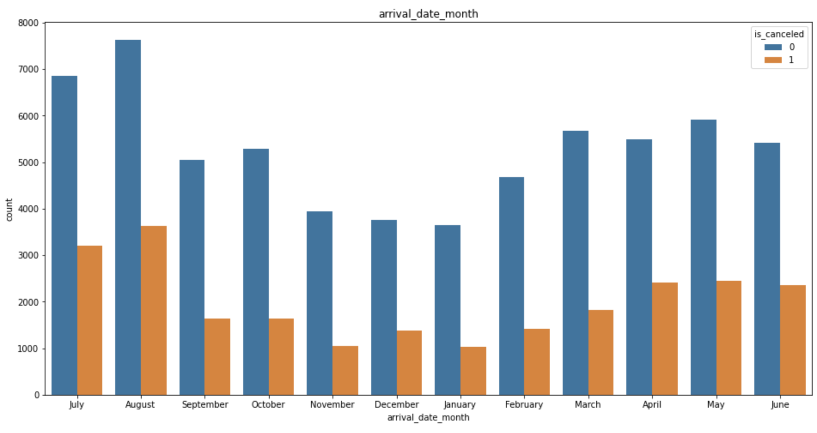
Visualization based on Target
Data Visualization
32%
31%
30%
29%
30%
24%
23%
24%
26%
23%
21%
22%

Slide 30
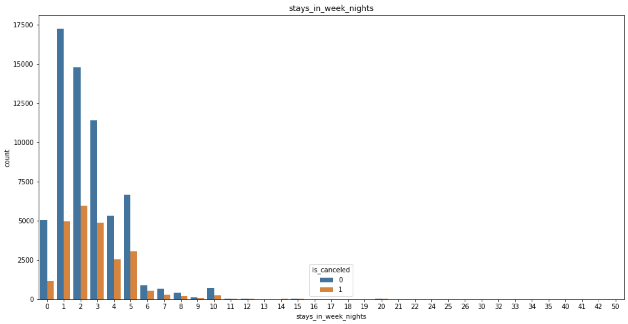
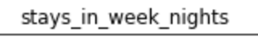
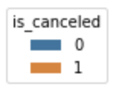
Stays in Week Nights
Data Visualization

Slide 31
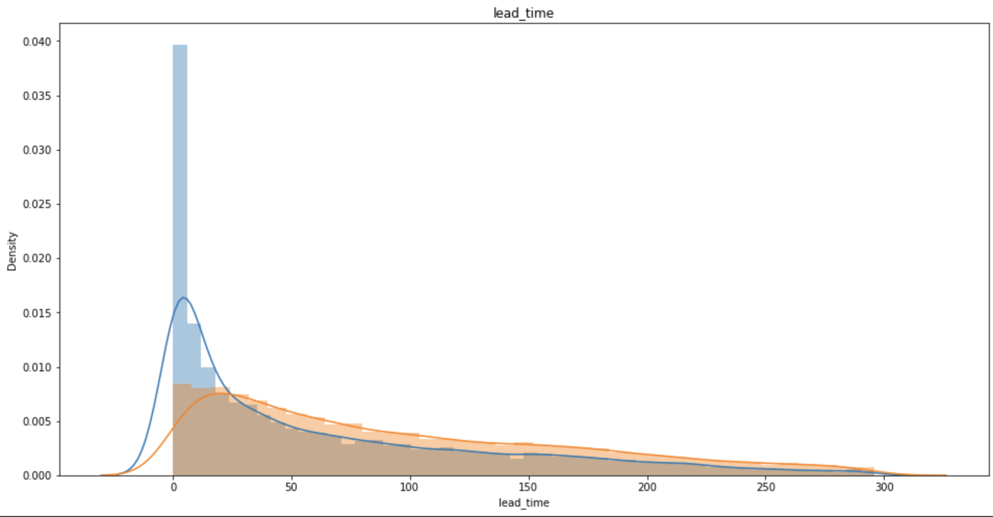
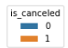
Lead Time
Data Visualization
lead_time tinggi cenderung memiliki tingkat cancelation lebih tinggi

Slide 32
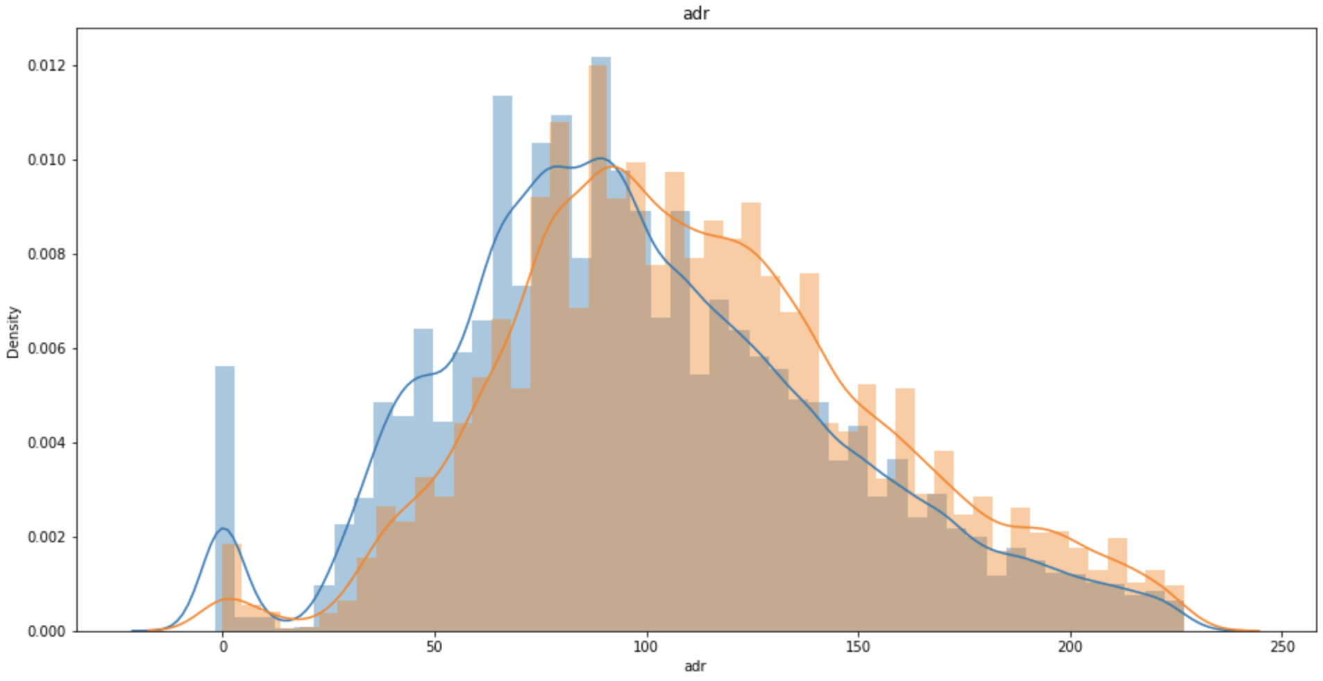
Average Daily Rate
Data Visualization

Slide 33
MODELLING
Modelling
Model yang digunakan:
LGBM
Random Forest
KNN
Decision Tree
Logistic Regression
Notes:
Light Gradient Boosting Machine

Slide 34
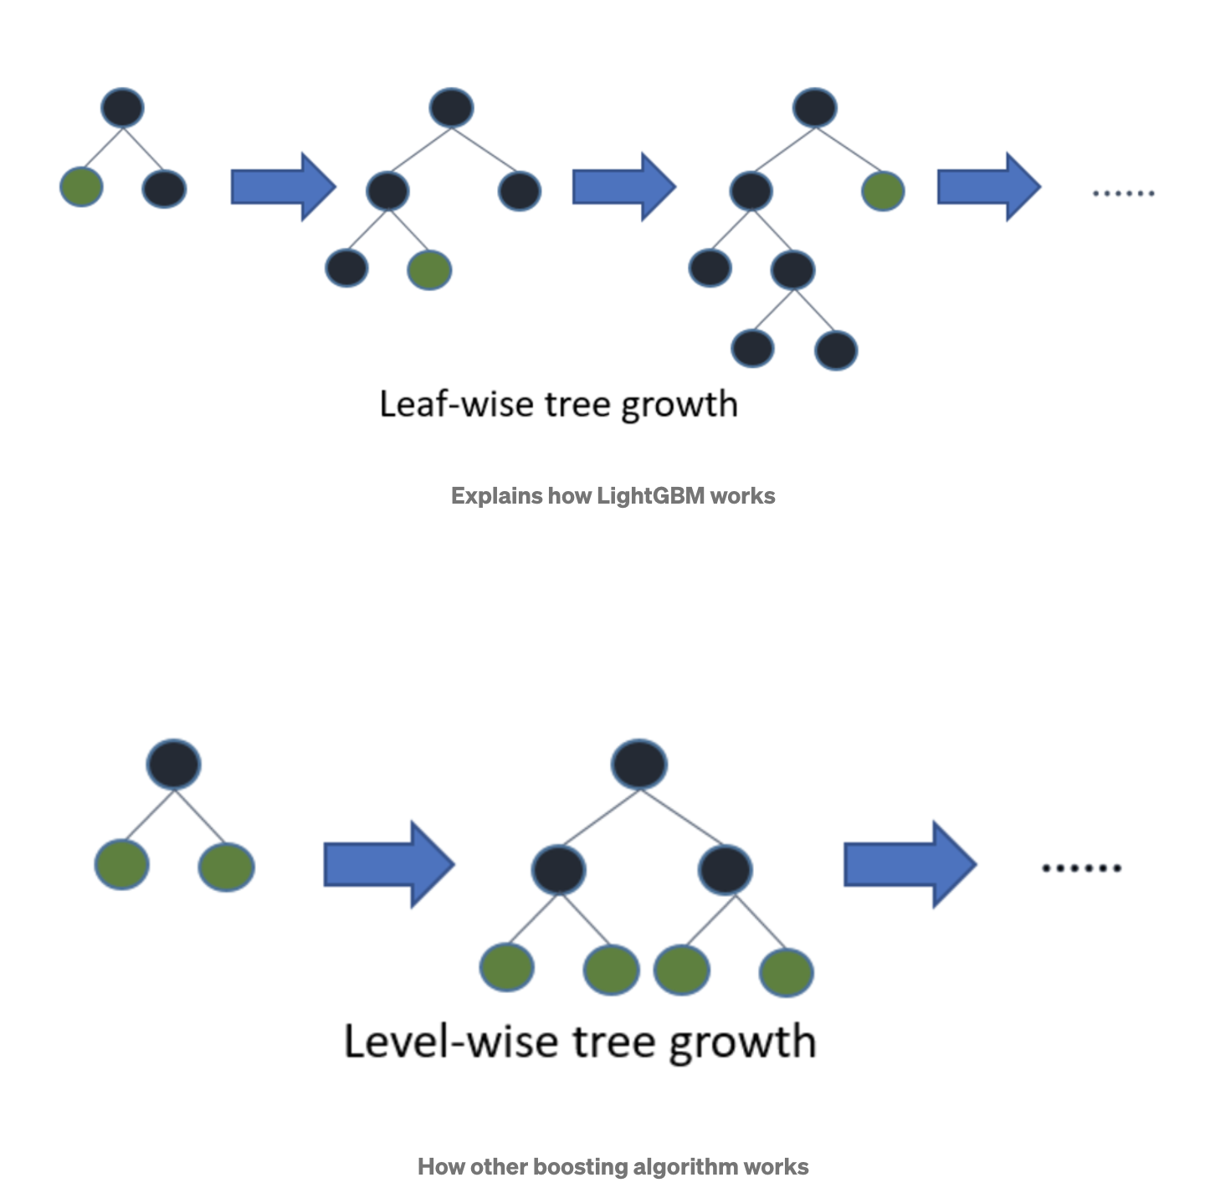
Teori LGBM
Modelling
Cocok untuk data ukuran besar di atas 10000 baris data, jika terlalu kecil cenderung mudah overfit
Cenderung lebih cepat, dapat menghandle data yang besar dan memerlukan memori yang lebih rendah
Notes:
Light GBM is a gradient boosting framework that uses tree based learning algorithm.
Light GBM grows tree vertically while other algorithm grows trees horizontally meaning that Light GBM grows tree leaf-wise while other algorithm grows level-wise. It will choose the leaf with max delta loss to grow. When growing the same leaf, Leaf-wise algorithm can reduce more loss than a level-wise algorithm.
Light GBM adalah kerangka kerja peningkatan gradien yang menggunakan algoritma pembelajaran berbasis pohon.
Light GBM menumbuhkan pohon secara vertikal sementara algoritme lain menumbuhkan pohon secara horizontal yang berarti lgbm menumbuhkan pohon leaf-wise atau berdasarkan daun sementara algoritme lain level-wise. Saat menumbuhkan daun yang sama, algoritma Leaf-wise dapat mengurangi lebih banyak kerugian daripada algoritma level-wise.

Slide 35
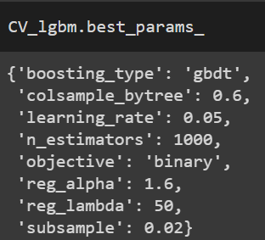
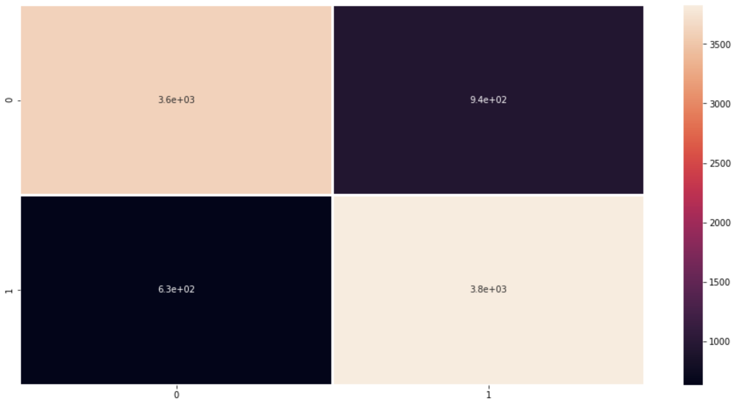
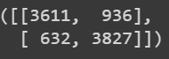
LGBM
Modelling
Confusion Matrix
Notes:
Tidak ada yang tinggi

Slide 36
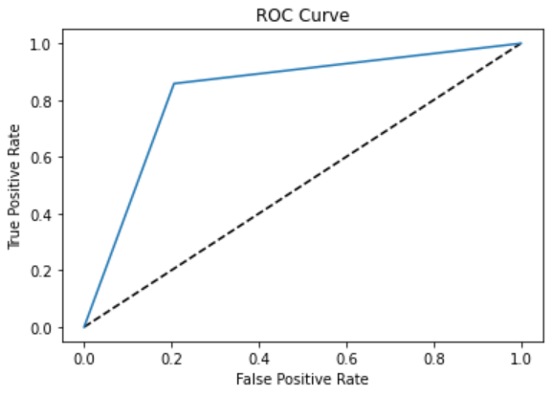
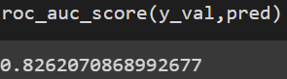
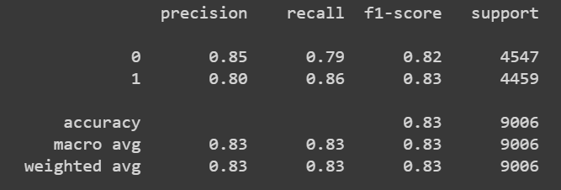
LGBM
Modelling
Notes:
Tidak ada yang tinggi

Slide 37
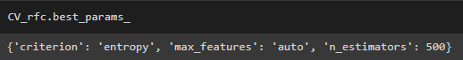

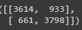
Random Forest
Modelling
Confusion Matrix
Notes:
Tidak ada yang tinggi

Slide 38
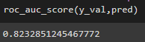
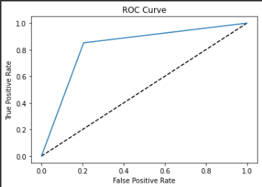
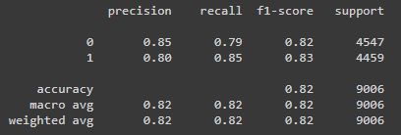
Random Forest
Modelling
Notes:
Tidak ada yang tinggi

Slide 39
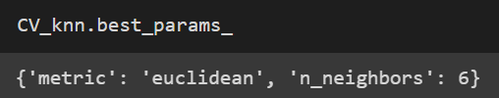

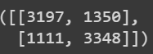
KNN
Modelling
Confusion Matrix
Notes:
Tidak ada yang tinggi

Slide 40
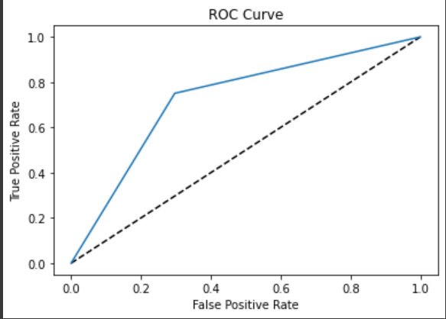
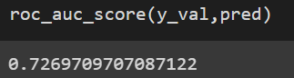
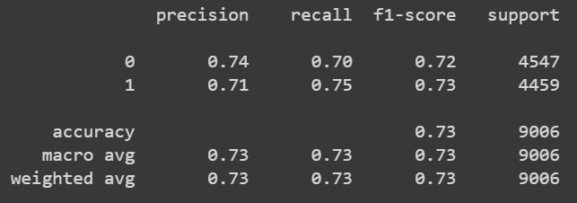
KNN
Modelling
Notes:
Tidak ada yang tinggi

Slide 41
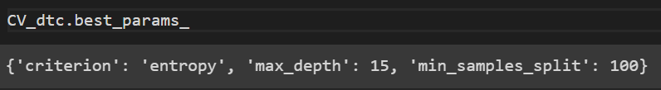
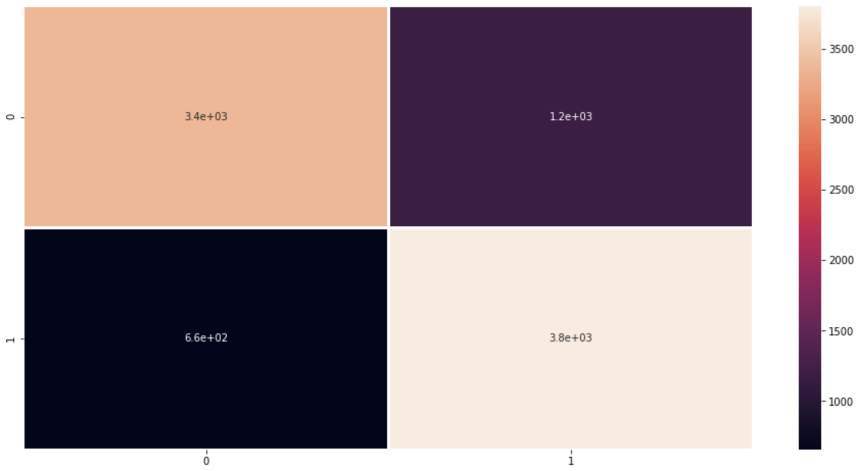
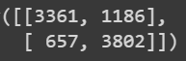
Decision Tree
Modelling
Confusion Matrix
Notes:
Tidak ada yang tinggi

Slide 42
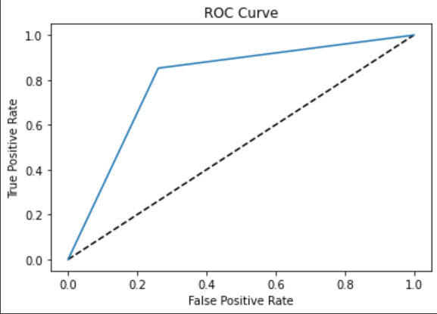
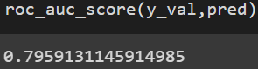

Decision Tree
Modelling
Notes:
Tidak ada yang tinggi

Slide 43


Logistic Regression
Modelling
Notes:
Tidak ada yang tinggi

Slide 44

Logistic Regression
Modelling

Slide 45


Logistic Regression
Modelling

Slide 46
Hasil Train Model
Modelling
Model | Accuracy | ROC | Recall
LGBM | 0.825 | 0.826 | 0.86
Random Forest | 0.822 | 0.823 | 0.85
KNN | 0.72 | 0.726 | 0.75
Decision Tree | 0.79 | 0.796 | 0.85
Logistic Regression | 0.772 | 0.772 | 0.808

Slide 47

Feature Importance
Modelling

Slide 48


LGBM Feature Importance
Modelling

Slide 49

LGBM Feature Importance
Modelling

Slide 50
Kesimpulan
Final Project
Model berhasil dibangun dengan LGBM, Random Forest, Logistic Regression, dan Decision Tree, bisa memprediksi booking cancellation dengan cukup baik
Model LGBM dipilih sebagai model terbaik karena menghasilkan accuracy, ROC, dan recall tertinggi dan kecepatan yang lebih baik pada ukuran data yang digunakan (> 10000)

Slide 51
Aplikasi
Final Project
https://share.streamlit.io/hendraronaldi/hotel-demand-booking/app.py

